Slide 1
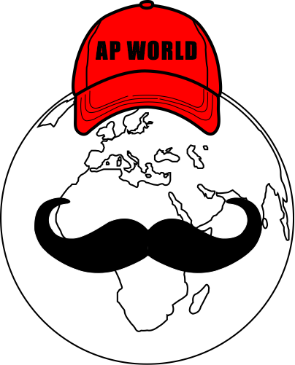
AP World Review: Modern: Video #4: Topic 1.4
Everything You Need To Know About Topic 1.4 To Succeed In AP World Modern
www.APWorldReview.com

Slide 2
The Aztecs
Spread to the Gulf of Mexico and Pacific
1325 - founded Tenochtitlan (present-day Mexico City)
City on an island of a swampy lake
200,000 People
Center of the city - Great Pyramid

Slide 3
The Aztecs
Agriculture:
Chinampas - floating gardens
Provided crops in addition to maize
Ditches helped use lake water to irrigate fields
Did not have:
Wheeled vehicles
Pack animals

Slide 4
The Aztecs
Government Structure:
Like the Chinese, they used a tribute system
Included food, cloth, luxury items such as feathers, beads, and jewelry
City-states were arranged into provinces
Government was a theocracy - rule by religious leaders

Slide 5
The Aztecs
Contributions:
365 day calendar
Trade:
Traded with present-day Costa Rica and California
Women:
Most worked inside homes
Some worked as priestesses, scribes

Slide 6
Decline Of The Aztecs
Tribute system put burdens on conquered people
1519 - Hernan Cortez and Spanish conquered the Aztecs
European diseases killed many Aztecs

Slide 7
Mayan City-States
Height between 250 and 900 C.E.
2 million Mayans in the region
Present-day Belize, Honduras, and Guatemala
Around 40 cities from 5,000 to 50,000 people
Agriculture:
Slash-and-burn
Terraced fields
Irrigation systems for corn, beans, and squash - three sisters

Slide 8
Mayan City-States
Temples, plazas, and palaces were located in the center
Temples were sometimes located on top of pyramids
Government Structure:
City-states were ruled by kings
Claimed to be divine
Wars between city-states
Gain tribute, rather than territory
Losers were sometimes sacrificed
Taxes and labor were given to the government from the common people
No standing militaries -> citizens joined military when war broke out
Powerful city-states would dominate regions

Slide 9
Mayan City-States
Religion:
Polytheistic - Gods of sun, rain, and corn
Priests had significant power
Achievements:
Could predict solar eclipses and moon phases -> without telescopes
Advanced calendar
Writing system -> similar to hieroglyphics
Written on paper
Decline:
Wars, drought, and environmental changes led to population decline
Abandoned city-states

Slide 10
Chaco
860 - 1130 C.E.
Located near the Rio Grande
Little infrastructure:
Lack of wheeled vehicles and large, domesticated animals
Advancements:
Astronomers
Turquoise jewelry - trade
1200 - Civilization was abandoned

Slide 11
Cahokia
Located near present-day St. Louis
900 - 1250 C.E.
Built giant mounds
Society:
Stratified
Agriculture was based on corn
Spread from Mexico

Slide 12
The Incas
Cuzco - capital of Inca Empire (present-day Chile)
Government Structure:
4 provinces, each with own governor
Conquered people did not pay tribute, rather gave public service - Mita system
Corvee labor, forced labor in China

Slide 13
The Incas
Economy:
Based on agriculture:
Maize, potatoes, tomatoes, squash, peanuts, cotton
Families had to turn a portion of crops over to ruler in case of famine

Slide 14
The Incas
Religion:
Ancestor veneration (Like China)
Honoring the Sun
Priests were often consulted prior to important decisions
Could interpret the Gods’ meaning through coca leaves
Sacrifices were made:
Corn, guinea pigs, Llamas, conquered people

Slide 15
Inca Contributions
Quipu - system of knotted strings
**Terrace fields**
Potatoes and maize
Built extensive roads
Helped unite the empire

Slide 16
Inca Decline
Conquered by Francisco Pizarro
Disease ravaged the Empire

Slide 17
Quick Recap
Mayan city-states:
Agriculture, irrigation, government structure, achievements
Chaco:
Little infrastructure
Advancements
Cahokia:
Giant mounds
Maize

Slide 18
See You Back Here For Video #5: Topic 1.5
Thanks for watching
Best of luck!

