Slide 1
AP World Review: Video #22: Bantu Migrations (Key Concept 3.1, II, B-C)
Everything You Need To Know About Bantu Migrations To Succeed In AP World
www.APWorldReview.com

Slide 2
Bantu Migrations
Bantu-speaking people originated in West Africa
Spread throughout 1/3 of the African continent
Most migrations involved small groups of people

Slide 3
Bantu Agriculture
Bantus produced a surplus of food
Yams, millet, sorghum
Forced the Bantus to expand
300 - 500 B.C.E.
Bananas were introduced from Indonesia
Increase in population
Bantus could move to land that did not allow for the cultivation of yams

Slide 4
Bantu Technology
500 B.C.E. - iron tools and weapons allowed them to clear land and be successful in battle
Think of environmental impacts
Canoes allowed them to travel on rivers in Africa

Slide 5
Bantu Societies
2000 B.C.E. - Bantus reached East Africa
Began raising sheep and cattle
400 C.E.
Bantu speaking people arrived in South Africa - end of migration
Societies were often matrilineal
Trace ancestry through their mothers

Slide 6
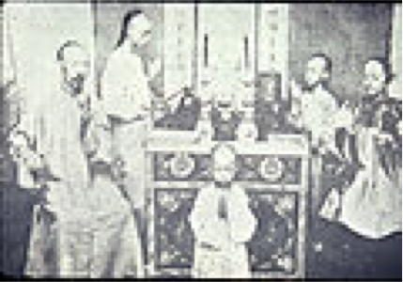
Bantu Religion & Arts
Many believed one God created the world that was inhabited by many spirits
Ancestor veneration
Masks and figures often represented dead ancestors

Slide 7
Quick Recap
Where did the Bantu originate?
Why did they migrate?
New technologies and crops?
How did they transform Africa as they migrated?

Slide 8
See You Back Here For Video #23: West & East Africa Kingdoms
Thanks for watching
Best of luck!

